Slide 1
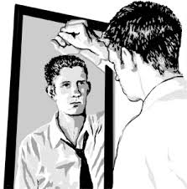
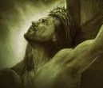
What We See!!!
What GOD Sees!!!
One is True and One is a Lie; So Which One Do You Believe??

